Slide 1
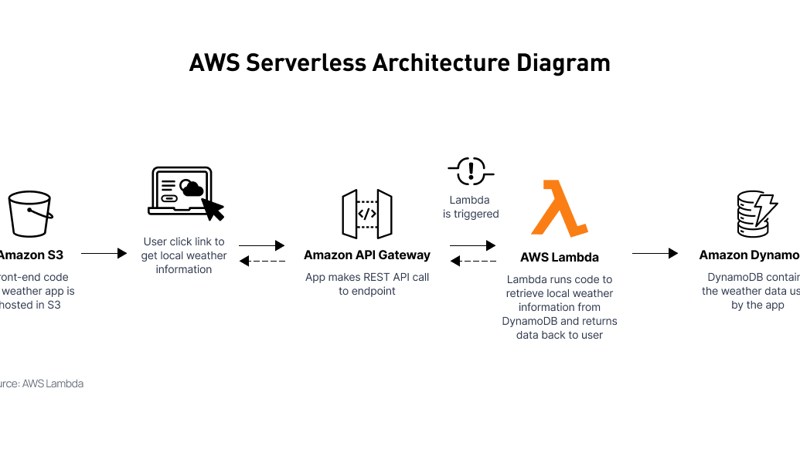


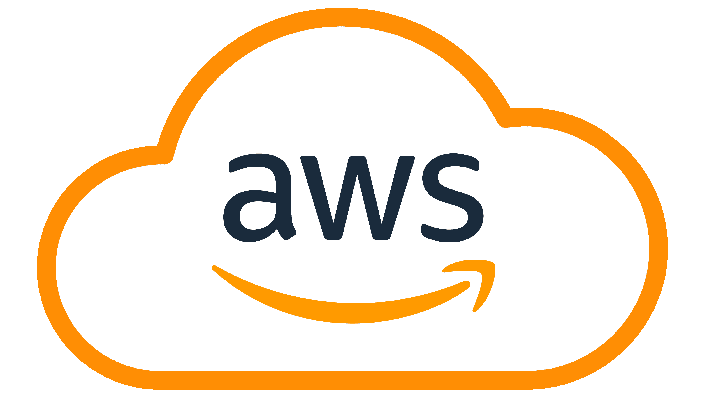
Cloud Solutions (k_MCS_010)
Serverless Telegram Bot
on AWS using Terraform
Infrastructure as Code • Serverless Architecture • Production-Grade Observability
Team Members
Technologies
Date
Abhishek Negi (100004670),
Shreeraj Patil (100004823),
Nirbhay Rohatgi(100003084)
Lambda • API Gateway • DynamoDB • S3 • Terraform
09 February 2026

Slide 2
PRESENTATION OVERVIEW
Agenda
01
Project Overview & Goals
02
Architecture & Development Journey
Objectives, outcomes, and project scope
System design and phased implementation
03
Infrastructure as Code with Terraform
04
Security & IAM Implementation
Modular structure, remote state, and automation
Least privilege access control and hardening
05
Bot Functionality & External APIs
06
Observability & Monitoring
Core commands and third-party integrations
Structured logging and CloudWatch alerts
07
Migration & Best Practices
08
Demo & Key Learnings
LocalStack to AWS and continuous improvement
Live demonstration and insights gained

Slide 3
PROJECT FOUNDATION
Project Goal & Objectives
Primary Objectives
Key Outcomes
Build a Fully Serverless Telegram Bot
Event-driven architecture with zero server management
Infrastructure as Code
Automate Infrastructure using Terraform
Complete infrastructure defined in Terraform with version control, enabling reproducible deployments across environments
Infrastructure as Code for reproducible deployments
Store User Data & Files
DynamoDB for state persistence, S3 for file storage
Secure Least-Privilege IAM
Migrate from LocalStack → Real AWS
Principle of least privilege enforced with granular permissions for each AWS service interaction
Environment-agnostic deployment strategy
Add Observability & External APIs
Production-grade logging, monitoring, and integrations
Production-Grade Observability
Structured logging, CloudWatch monitoring, and automated alerting for production readiness
3

Slide 4
SYSTEM DESIGN
High-Level Architecture
Event-driven serverless architecture with fully managed AWS services
Request Flow Architecture
User
HTTPS
Telegram
Webhook
API Gateway
Trigger
Lambda
Telegram Client
Bot API
HTTP Endpoint
Bot Logic
DynamoDB
S3
CloudWatch
External APIs
User notes & state persistence
File storage & retrieval
Logs, metrics & alarms
Third-party integrations
PutItem
GetItem
Query
PutObject
GetObject
List
Log Groups
Metrics
Alarms
Weather
News
Trivia
Compute & Routing
Storage & Data
External Services
4

Slide 5
IMPLEMENTATION ROADMAP
Development Journey Timeline
Phased approach from local development to production deployment
1-2
Environment Setup
Foundation
AWS service understanding, LocalStack configuration, Terraform installation, and initial project structure setup
3-6
Core Infrastructure & Bot Features
Development
Lambda function implementation, API Gateway webhook configuration, DynamoDB integration, S3 file handling, and core bot commands
7
Real AWS Migration
Migration
Removed LocalStack endpoints, configured real AWS provider, implemented LabRole IAM role, deployed live API Gateway webhook
8
Terraform Refactor & IAM Hardening
Optimization
Modular Terraform structure, least-privilege IAM implementation, standardized naming and tagging, remote state configuration
9
Logging & Monitoring
Observability
Structured logging implementation, CloudWatch log groups with retention policies, metric filters, and automated error alarms
10
External API Integrations
Enhancement
Weather API (Open-Meteo), News API (GDELT), Trivia API (OpenTriviaDB), Card game API (Deck of Cards) with error handling
5

Slide 6
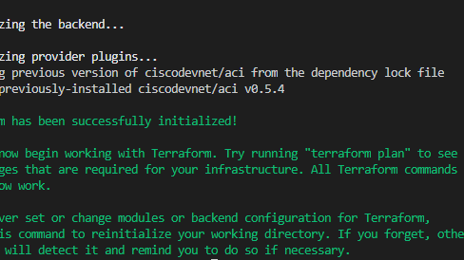
SECTION 01
Infrastructure & IaC
Terraform automation, modular architecture, and state management
Terraform
Modular Design
Remote State
6

Slide 7
INFRASTRUCTURE AUTOMATION
Terraform & Infrastructure as Code
Why Terraform?
Resources Managed
Reproducible Deployments
Infrastructure defined as code ensures identical environments across dev, staging, and production
Lambda
API Gateway
Bot logic execution, event-driven compute
Webhook endpoint, HTTP routing
Environment Independence
Same codebase deploys to LocalStack or real AWS with provider configuration changes only
DynamoDB
S3
Automated Provisioning
User data persistence, state management
File storage, media handling
Single command (terraform apply) creates or updates entire infrastructure stack
IAM
CloudWatch
Roles, policies, least-privilege access
Logging, metrics, alarms
Industry Best Practice
Infrastructure as Code brings version control, repeatability, and automation to cloud resource management, eliminating manual configuration errors and enabling collaborative development workflows.
7

Slide 8
CODE ORGANIZATION
Modular Terraform Structure
Refactoring from monolithic to modular architecture
Before
After
Single main.tf
modules/ Directory
All resources in one massive file, difficult to navigate and maintain
lambda
api_gateway
dynamodb
s3
Hardcoded Values
iam
cloudwatch
No variables or reusability, environment-specific values embedded
Variables & Locals
Broad IAM Permissions
Configurable inputs, environment-specific values, reusable components
Wildcard permissions, excessive access rights, security risk
Outputs
Exposed resource attributes, inter-module dependencies, useful endpoints
Benefits of Modular Design
Clean structure
Reusable components
Easier maintenance
Reduced blast radius
8

Slide 9
STATE MANAGEMENT
Remote State & Environment Management
Terraform State in S3
Production-Ready Workflow
Encryption at Rest
State file encrypted using AWS KMS for security compliance
1
State Isolation
Separate state files per environment (dev/staging/prod)
Versioning Enabled
Automatic state versioning for recovery and audit trails
Team Collaboration
2
Explicit Ownership
Shared state enables multiple team members to work safely
Clear state file ownership prevents conflicting updates
3
Mandatory Locking
Prevents parallel operations from corrupting state
State Locking via DynamoDB
DynamoDB table provides distributed locking mechanism, preventing concurrent terraform operations that could corrupt state. Essential for team environments and CI/CD pipelines.
Best Practice
Remote state is the backbone of multi-team Terraform setups
9

Slide 10

SECTION 02
Security & IAM
Least privilege access control and security hardening
Least Privilege
IAM Roles
Access Control
10

Slide 11
SECURITY HARDENING
IAM Least Privilege Implementation
Before: Broad Permissions
After: Least Privilege
# ANTI-PATTERN: Overly permissive
# BEST PRACTICE: Granular permissions
resource"aws_iam_policy""lambda_policy" {
policy = jsonencode({
Version = "2012-10-17"
Statement = [
{
Effect = "Allow"
Action = "*" # ALL ACTIONS!
Resource = "*" # ALL RESOURCES!
}
]
})
}
resource"aws_iam_policy""lambda_policy" {
policy = jsonencode({
Statement = [
{# DynamoDB - Specific Table
Action = [
"dynamodb:PutItem",
"dynamodb:GetItem",
"dynamodb:Query"
]
Resource = "arn:aws:dynamodb:::table/bot-data"
},
{# S3 - Specific Bucket
Action = [
"s3:PutObject",
"s3:GetObject",
"s3:ListBucket"
]
Resource = "arn:aws:s3:::bot-files/*"
}
]
})
}
Wildcard actions (*)
Specific actions only
Wildcard resources (*)
Named resources
Security vulnerability
Principle of least privilege
Violates least privilege
Production-ready security
11
Security Result
Lambda function has access only to required resources with minimal permissions. Principle of least privilege enforced for secure production deployment.

Slide 12
SECTION 03
Bot Functionality
Core commands, features, and external integrations
Bot Commands
Data Persistence
External APIs
12

Slide 13
BOT CAPABILITIES
Core Bot Commands & Features
Interactive commands demonstrating serverless service integration
Basic Commands
DynamoDB Persistence
S3 File Storage
/hello
/save
File Upload
Greeting message with bot introduction
Save user note to DynamoDB
Users send files via Telegram, stored in S3
PutItem
user_id
timestamp
PutObject
unique_key
/help
List all available commands and usage
/get
File List
Retrieve saved notes
List all uploaded files
/echo
GetItem
Query
user_id
ListObjects
user prefix
Echo back user message (parameter handling)
File Download
Download uploaded files
user prefix
unique_key
All commands processed through Lambda with sub-100ms response time
Demonstrates compute + database integration in serverless architecture
Demonstrates compute + storage integration with automatic scaling
13

Slide 14
THIRD-PARTY INTEGRATIONS
External API Integrations
Real-world microservice communication patterns
Weather
News
Why This Matters
Open-Meteo API
GDELT API
Real-World Microservice Communication
Real-time weather data by location with 7-day forecast
Global news events and trending topics with sentiment
Demonstrates HTTP client patterns in serverless functions
Error Handling & Timeouts
HTTP GET
JSON
HTTP GET
JSON
Graceful degradation when external services fail
No Hardcoded Secrets
API keys and endpoints via environment variables
Trivia
Cards
OpenTriviaDB API
Deck of Cards API
Quiz questions across categories with difficulty levels
Virtual deck operations: shuffle, draw, and card games
HTTP GET
JSON
HTTP GET
JSON
Production-ready external service integration patterns
14

Slide 15
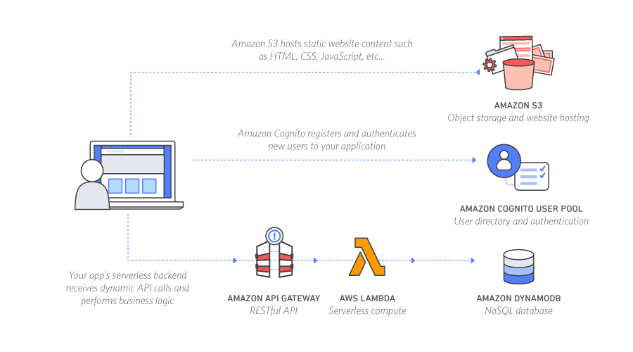
SECTION 04
Observability & Operations
Logging, monitoring, and production alerting
Structured Logging
CloudWatch
Alerts
15

Slide 16
PRODUCTION OBSERVABILITY
Structured Logging
Every Lambda request captures comprehensive context for debugging
Log Entry Structure
Logged Fields
{
"timestamp": "2026-02-06T10:30:45.123Z",
"level": "INFO",
"request_id": "abc123-def456",
"user_id": 123456789,
"command": "/weather",
"action": "fetch_weather",
"outcome": "success",
"duration_ms": 245,
"parameters": {"city": "London"},
"stack_trace": null
}
timestamp
ISO 8601 format
level
INFO/ERROR
request_id
Trace correlation
user_id
User context
command
Bot command
action
Internal action
outcome
success/fail
stack_trace
Error details
Production-Ready
Error logs include full stack traces for rapid root cause analysis
Debuggable, queryable, and monitorable
16

Slide 17
MONITORING & ALERTING
CloudWatch Log Management & Error Monitoring
CloudWatch Log Groups
Error Monitoring & Alerts
Dedicated Log Group per Lambda
/aws/lambda/telegram-bot-function
Metric Filter
Retention Policy: 14 Days
Detects log entries with level=ERROR
Cost-optimized log storage with sufficient history
{ $.level = "ERROR" }
Fully Managed by Terraform
Infrastructure as Code for observability resources
CloudWatch Alarm
Triggers when ≥1 error in 5 minutes
Threshold: 1
Period: 5 min
Production Observability
All CloudWatch resources defined in Terraform modules for consistency
Automatic failure detection with actionable alerts
17

Slide 18
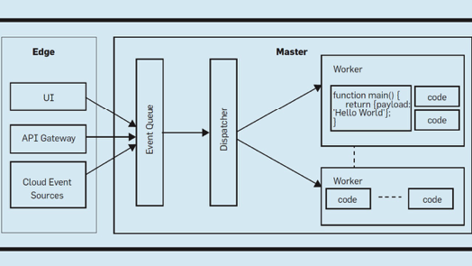
SECTION 05
Migration & Best Practices
LocalStack to AWS migration and continuous improvement
Migration
Gap Analysis
Best Practices
18

Slide 19
ENVIRONMENT MIGRATION
LocalStack → Real AWS Migration
Proving Infrastructure as Code value through environment portability
What Changed
What Stayed Same
Removed LocalStack Endpoints
Same Terraform Code
No more localhost:4566 service URLs
Infrastructure definitions unchanged
Real AWS Provider
Same Lambda Logic
provider "aws" with real region and credentials
Python bot code required no modifications
Real IAM Role (LabRole)
Actual AWS IAM role with proper permissions
Live API Gateway Webhook
Public HTTPS endpoint for Telegram integration
Proof of IaC Value
Environment-agnostic deployment strategy validated. Same codebase deploys to local emulation or production cloud with only provider configuration changes.
19

Slide 20
CONTINUOUS IMPROVEMENT
Gap Analysis & Refactoring Outcomes
Before vs After comparison across key areas
Area | Before | After | Impact
Terraform Structure | Flat | Modular | Reusable components, easier maintenance
IAM Permissions | Broad | Least Privilege | Security hardening, compliance ready
Naming & Tagging | Inconsistent | Standardized | Better resource management, cost tracking
State Management | Local | Remote (S3) | Team collaboration, state locking
Outputs | None | Useful Endpoints | Inter-module dependencies, API URLs
Maintainability
Security
Collaboration
Modular structure reduces complexity and enables parallel development
Least privilege IAM reduces attack surface and meets compliance
Remote state enables team workflows with conflict prevention
20

Slide 21
LIVE DEMONSTRATION
Live Demo Flow
End-to-end system functionality showcase
1
terraform apply
Infrastructure
Deploy complete serverless stack with single command
2
Telegram Commands
Bot Features
/hello, /help, /echo demonstrating basic command handling
3
Save & Retrieve Data
DynamoDB
/save and /get commands with DynamoDB persistence
4
Upload File
S3 Storage
File upload to S3 and list files command
5
Weather/News API
External APIs
Real-time data from Open-Meteo and GDELT
6
CloudWatch Logs
Observability
Inspect structured logs in CloudWatch console
7
Error Alarm Trigger
Monitoring
Demonstrate automatic error detection and alerting
21

Slide 22
PROJECT REFLECTION
Key Learnings & Insights
Critical lessons from building a production-ready serverless application
Infrastructure Automation is Critical
APIs Integrate Easily in Serverless
Terraform's Infrastructure as Code enables reproducible deployments, version control, and eliminates configuration drift. Manual resource management is error-prone and non-scalable.
External HTTP APIs integrate seamlessly with Lambda. Error handling, timeouts, and retry logic are critical for resilient microservice communication.
Security Must Be Explicit
Terraform Scales Cleanly with Modules
Least privilege IAM is not optional in production. Broad permissions create attack surfaces. Security must be designed in from the start, not bolted on later.
Modular design enables code reuse, reduces blast radius, and supports team collaboration. Flat monolithic configurations become unmaintainable as projects grow.
Observability is Essential in Production
Serverless is Production-Ready
Structured logging, metrics, and alarms are not nice-to-haves. Without visibility, debugging production issues becomes impossible. CloudWatch integration is mandatory.
AWS Lambda, API Gateway, DynamoDB, and S3 form a robust, scalable, and cost-effective platform for event-driven applications with automatic scaling.
22

Slide 23
PROJECT OUTCOME
Final System Capabilities
Production-ready serverless application demonstrating industry best practices
Fully Serverless
Secure IAM
Real AWS Deployment
Zero server management with automatic scaling
Least privilege access control enforced
Live production environment with real services
Granular
Named Resources
No Wildcards
Lambda
API Gateway
DynamoDB
S3
Live API
Real Data
Production
Monitoring & Alerting
External Integrations
Automated Lifecycle
Comprehensive observability with CloudWatch
4 live HTTP APIs with error handling
Complete IaC automation with Terraform
Weather
News
Trivia
Cards
Logs
Metrics
Alarms
Provision
Update
Destroy
Production-Ready Serverless Application
Industry Best Practices
23

Slide 24
ROADMAP AHEAD
Future Work & Enhancements
Potential next steps for extending the serverless bot platform
ChatGPT API Integration
Multi-Environment Setup
CI/CD Pipeline
Integrate OpenAI's GPT API for AI-powered conversational responses, natural language understanding, and intelligent bot interactions beyond static commands.
Implement separate dev/staging/prod environments with environment-specific configurations, isolated state files, and promotion pipelines.
Automated continuous integration and deployment with GitHub Actions or AWS CodePipeline for automated testing, security scanning, and zero-downtime deployments.
AI
NLP
Conversational
Dev
Staging
Prod
Automation
Testing
Deployment
Rate Limiting
Authentication Layer
More Ideas
Implement API Gateway throttling and usage plans to prevent abuse, control costs, and ensure fair resource allocation across users.
Add user authentication with Amazon Cognito or custom authorizers for protected commands, user management, and personalized experiences.
• Database caching with ElastiCache
• Message queuing with SQS
• Scheduled tasks with EventBridge
• Analytics with Kinesis
Throttling
Cost Control
Protection
Cognito
Auth
Security
• Multi-region deployment
24

Slide 25
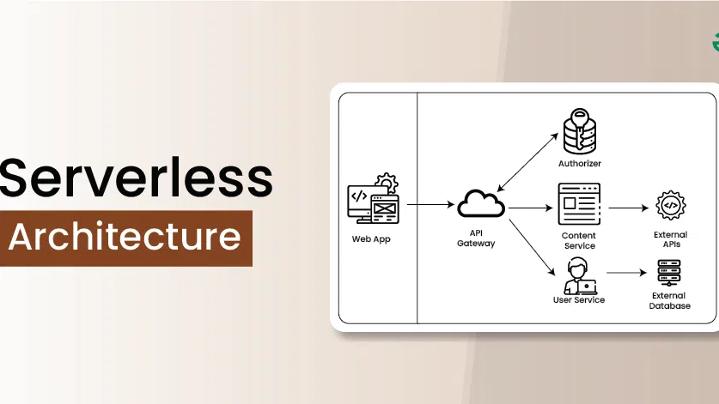

Thank You
We appreciate your time and attention
Team
Technologies
Date
Cloud Solutions Course
AWS • Terraform • Serverless
09 February 2026

